Slide 1
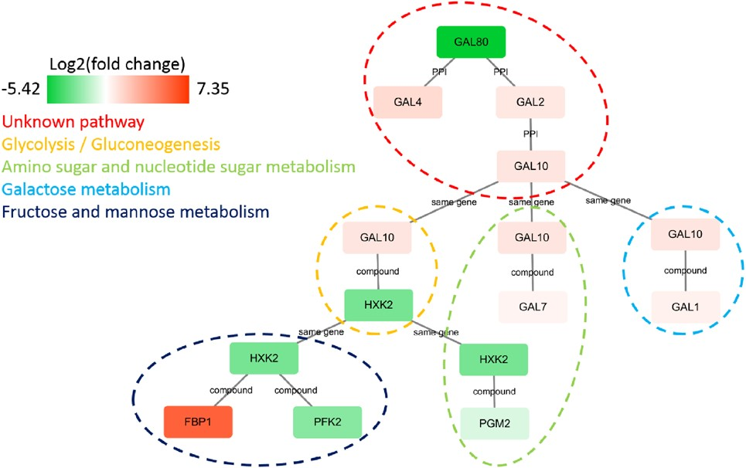

Fig. 5. The IMPRes results on a yeast perturbation experiment in which the gene GAL80 is knocked out. The genes are ...
Notes:
Fig. 5. The IMPRes results on a yeast perturbation experiment in which the gene GAL80 is knocked out. The genes are colored based on their log2 expression ratio against wild-type. The genes that belong to the same pathway are grouped together using different colors. For gene GAL4 and GAL80, they do not have pathway information in KEGG. They can only be connected by PPI, and thus their pathway annotation in the graph is unknown
Unless provided in the caption above, the following copyright applies to the content of this slide: © The Author(s) 2019. Published by Oxford University Press. All rights reserved. For permissions, please e-mail: journals.permissions@oup.comThis article is published and distributed under the terms of the Oxford University Press, Standard Journals Publication Model (https://academic.oup.com/journals/pages/open_access/funder_policies/chorus/standard_publication_model)

